Slide 1
Cyclic Boosting
A Pure-Python, Explainable, and Efficient ML Method
Felix Wick, June 2024

Slide 2
This is old stuff.

Slide 3
But it just works.

Slide 4
Cyclic Boosting ML Methods
family of off-the-shelf, general-purpose supervised machine learning methods for both regression and classification tasks (focus on structured data)
closest relatives: Generalized Additive Models (not a deep learning approach)
main difference: estimation of factors for each bin of the different features (instead of estimation of parameters like coefficients in linear regression or weights in neural networks)
→ individual explainability
scientific papers describing the methods: Cyclic Boosting, Demand Forecasting with Cyclic Boosting
4

Slide 5
Cyclic Boosting Library
scikit-learn-like usage of library
open source: https://github.com/Blue-Yonder-OSS/cyclic-boosting
Python package: pypi
documentation: readthedocs
5

Slide 6

Cyclic Boosting | Different Modes/Scenarios
Mulitplicative Regression
Additive Regression
Negative Binomial Width
Exponential Price Elasticity
Background Subtraction
Classification
(conditional mean)
(conditional mean)
(probability)
(dispersion parameter)
(elasticity parameter)
(conditional mean)
Y ∈ [0, ∞)
Y ∈ (-∞, ∞)
Y ∈ [0, 1]
Y ∈ [0, 1]
Y ∈ [0, ∞)
Y ∈ (-∞, ∞)
Poisson / Negative Binomial distribution
(link function ln)
Gaussian
distribution
(link function identity)
Bernoulli distribution
(link function logit)
Negative Binomial distribution
(link function logit)
exponential distribution
(link function ln)
Gaussian
distribution
(link function identity)
example
example
example
example
example
example
demand forecasts (mean)
profit predictions
churn probability
demand forecasts as full probability distributions
individual price-demand elasticities
individual causal effects, e.g., customer targeting

Slide 7
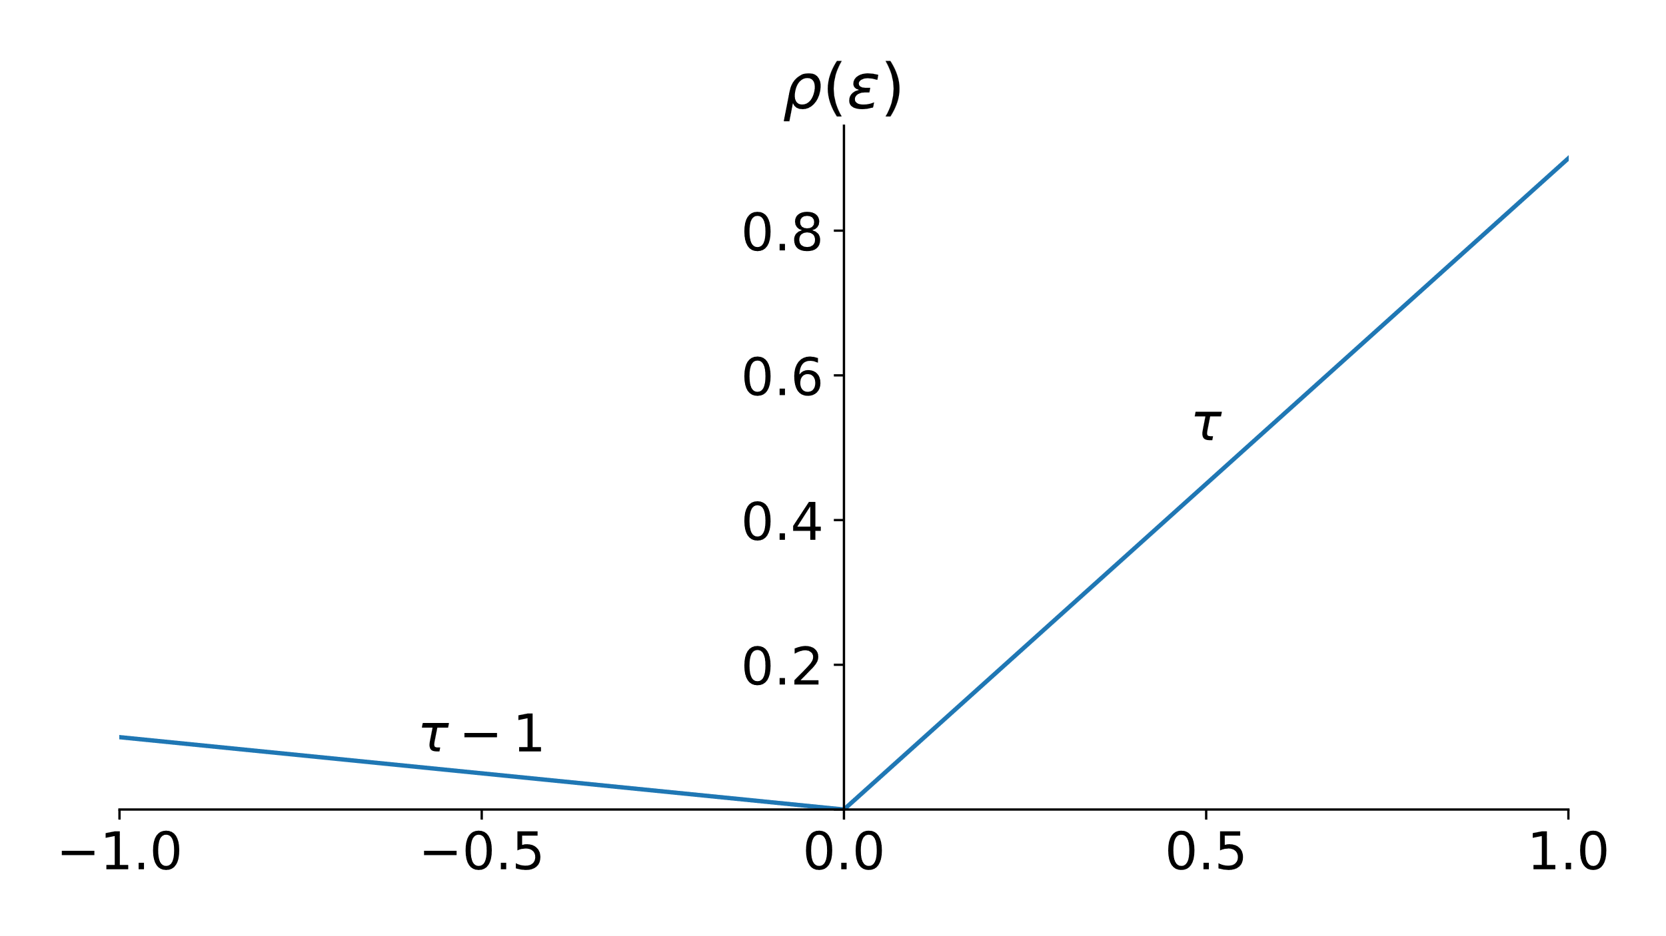
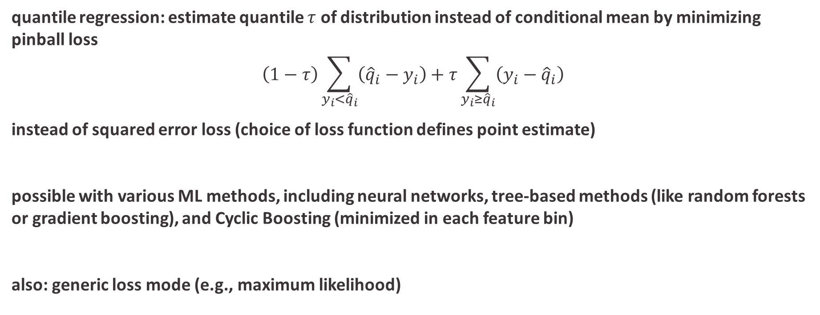
Also Possible: Quantile Regression
quantile regression: estimate quantile $τ$ of distribution instead of conditional mean by minimizing pinball loss
$$\left(1−τ\right)\sum_{y_{i}<{\hat{q}}_{i}}{\left({\hat{q}}_{i}−y_{i}\right)+τ\sum_{y_{i}≥{\hat{q}}_{i}}{\left(y_{i}−{\hat{q}}_{i}\right)}}$$
instead of squared error loss (choice of loss function defines point estimate)
possible with various ML methods, including neural networks, tree-based methods (like random forests or gradient boosting), and Cyclic Boosting (minimized in each feature bin)
also: generic loss mode (e.g., maximum likelihood)
from Wikipedia
7

Slide 8

Example Use Case: Demand Forecasting
many individual time series to consider
advantages of machine learning over traditional univariate time series forecasting
typical retail grocery chain:
products (items): ~20k
locations (stores): ~500
daily/hourly aggregated sales
combined learning on all time series of product-location combinations (rather than separately optimizing individual time series)
→ reduces variance by exploiting commonalities
natural consideration of many exogenous variables (prices, promotions, holidays, weather, ...)
→ reduces bias
promotions
(price reductions)
Summed Units
to be noted:
categorical features important (products and locations → high cardinality)
mainly multiplicative effects
demand (approximately) following Poisson (or rather negative binomial) distribution

Slide 9
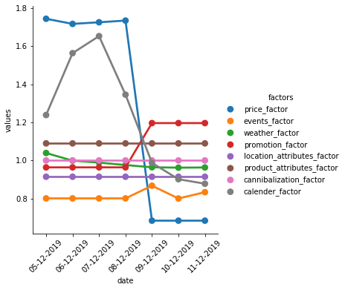
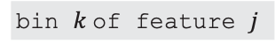
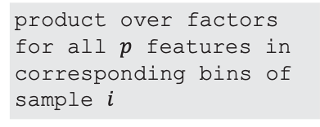
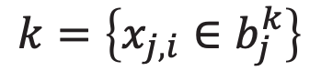
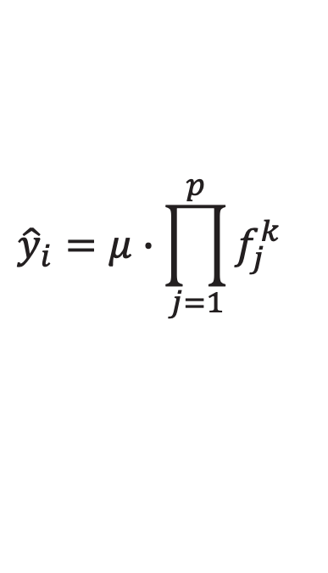
Cyclic Boosting - Prediction View | Individual Explainability
multiplicative model
Cyclic Boosting in multiplicative regression mode
variation proportional to level
individual item-store-day predictions
Cyclic Boosting allows for detailed explanation of each individual prediction by means of contributions (in form of factors) of each feature in the model.
prediction: look up learned factors of relevant bin for each feature
$${\hat{y}}_{i}=μ∙\prod_{j=1}^{p}{f_{j}^{k}}$$
with
$$k=\left\{x_{j,i}∈b_{j}^{k}\right\}$$
global target average
product over factors for all $p$ features in corresponding bins of sample $i$
bin $k$of feature $j$
no sequence model (like transformers), use i.i.d. assumption
data binning of features
(think of histograms)
do not confuse explainability with causality though
→ need for causal assumptions (e.g., specific smoothing)

Slide 10
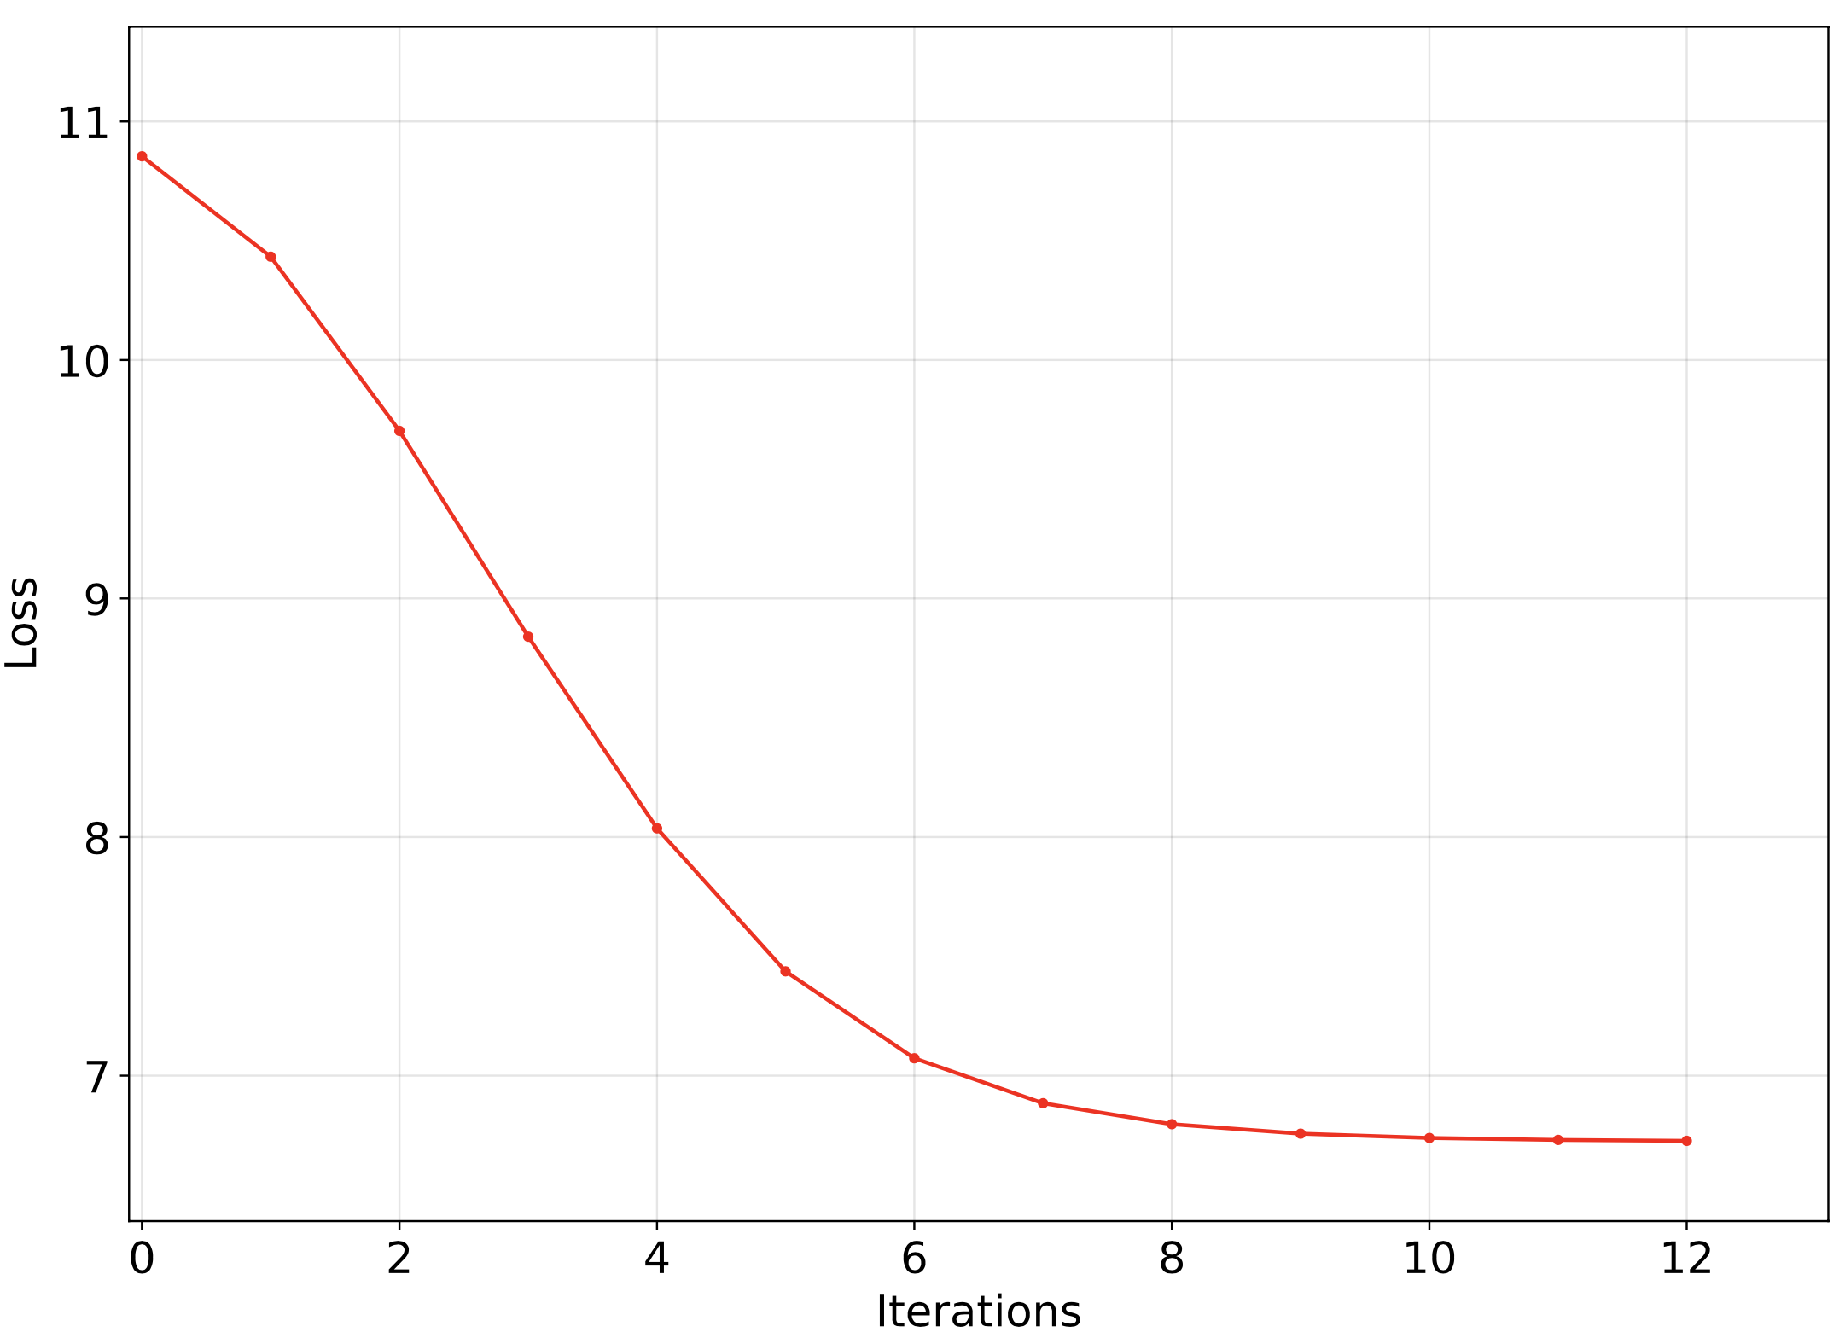
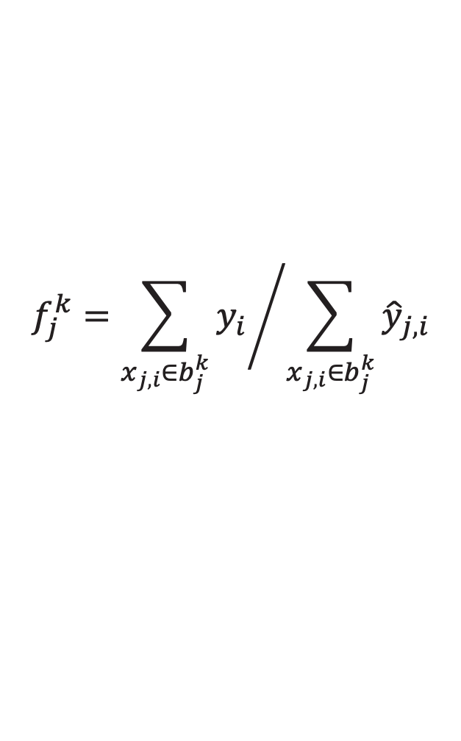
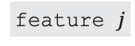
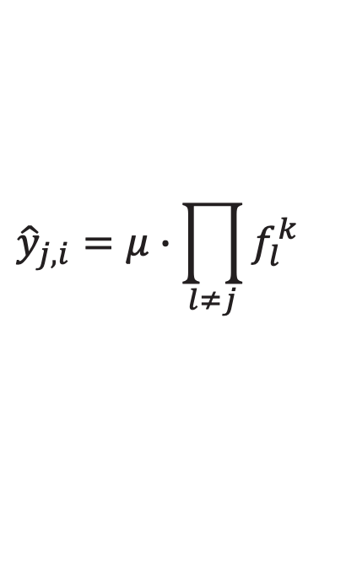
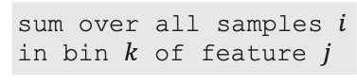
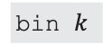
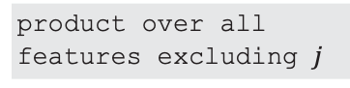
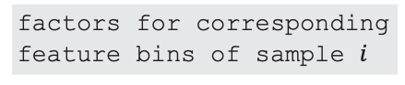
Cyclic Boosting Training Coordinate Descent: Boosting-like Update of Factors
Cyclic Boosting fitting procedure with three loops
while (stop criteria)
…
for (features)
…
for (samples)
iterations
sequential
calculate global average µ, initialize all factors to 1
parallel
cyclically iterate through features and calculate factors for each feature bin (corresponding to minimization of quadratic loss)
multiplicative regression mode
(other modes work accordingly)
bin $k$
numerator: target values
factors for corresponding feature bins of sample $i$
$$f_{j}^{k}={\sum_{x_{j,i}∈b_{j}^{k}}{y_{i}}}/{\sum_{x_{j,i}∈b_{j}^{k}}{{\hat{y}}_{j,i}}}$$
$${\hat{y}}_{j,i}=μ∙\prod_{l≠j}{f_{l}^{k}}$$
for simplicity: show only non-aggregated mode
product over all features excluding $j$
feature $j$
denominator: predictions excluding factor from current feature
sum over all samples $i$ in bin $k$ of feature $j$
stop according to MAD or MSE criteria at end of iterations (full feature cycles) or when reaching given maximal number of iterations

Slide 11
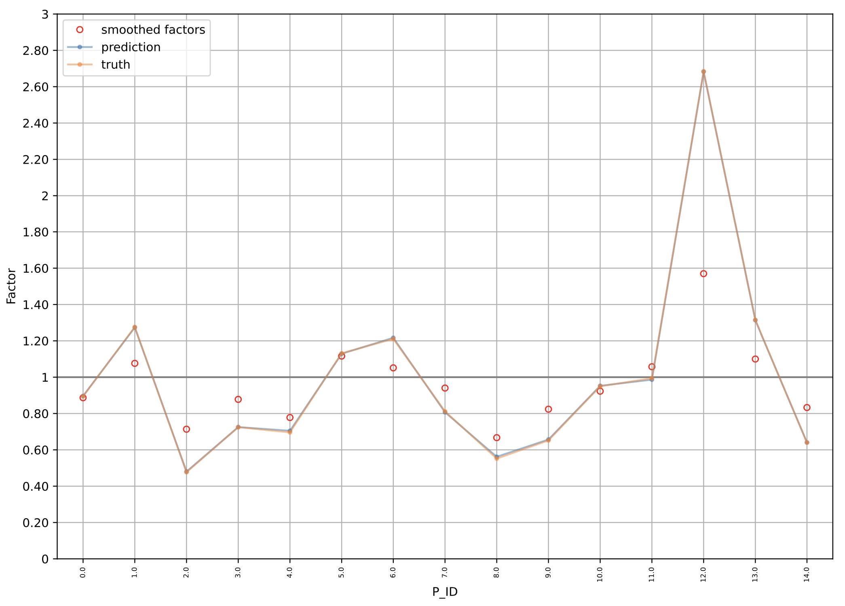
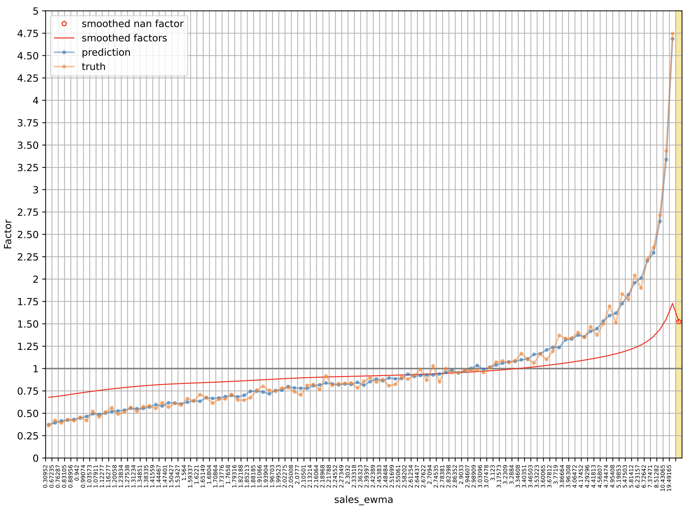
Binning
continuous features discretized to:
either having same bin width (equidistant binning)
or containing approximately same number of observations (equistatistics binning) with different bin widths
categorical features retain original categories (learning of specific factor for each of the bins)
→ supporting categorical features with high cardinality
truth = average of target values for all the observed training samples in this bin divided by the global average of target values
missing values (nan) learned separately
(can also be set to uninformative factor, i.e., 1)
y axis: factors for each bin
x axis: e.g., product IDs as bins
local optimization in each bin: allows learning of rare effects with low bias

Slide 12
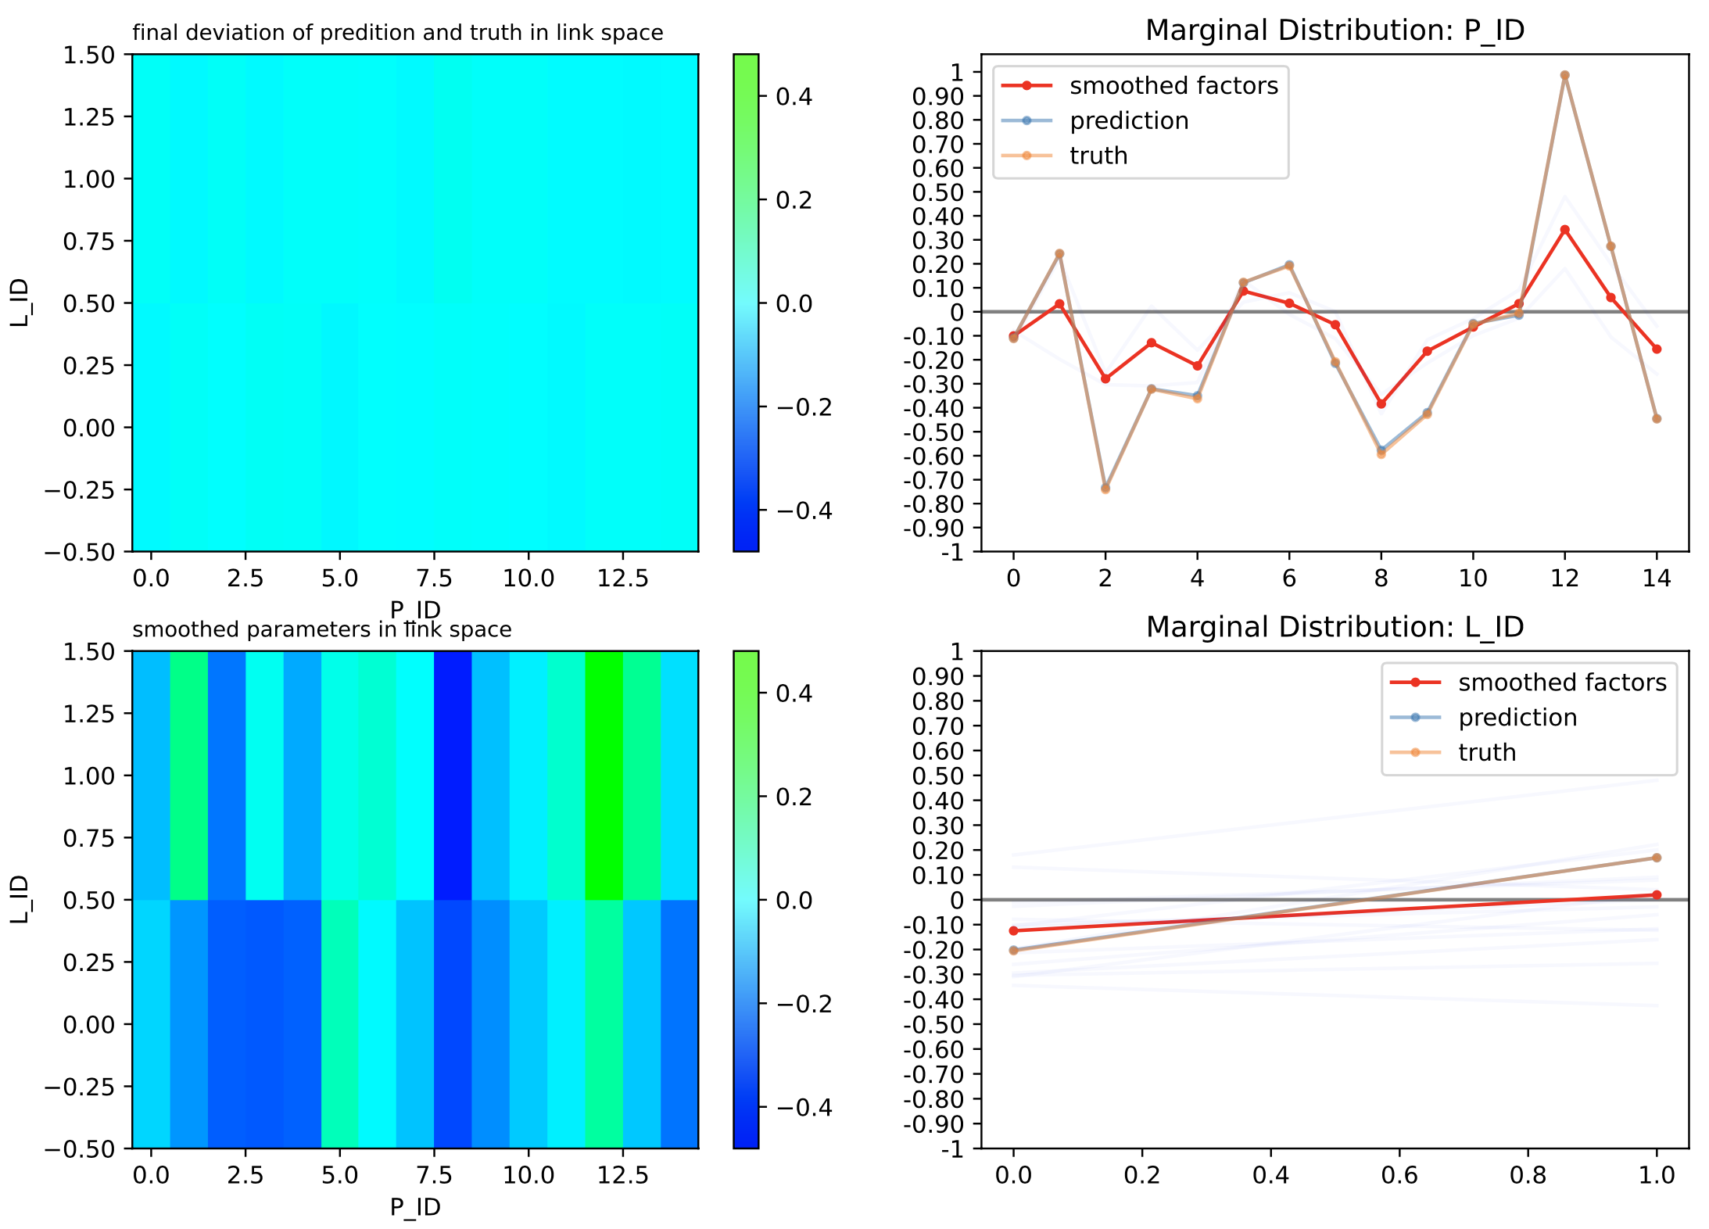
Interaction Terms
e.g., different holiday effects for different products
require even more local optimization (rare effects)
→ include binned interaction terms (e.g., 2D or 3D)
can (partly) enable hierarchical model structure (in combination with coordinate descent): interaction terms with product groups, products, locations
12

Slide 13
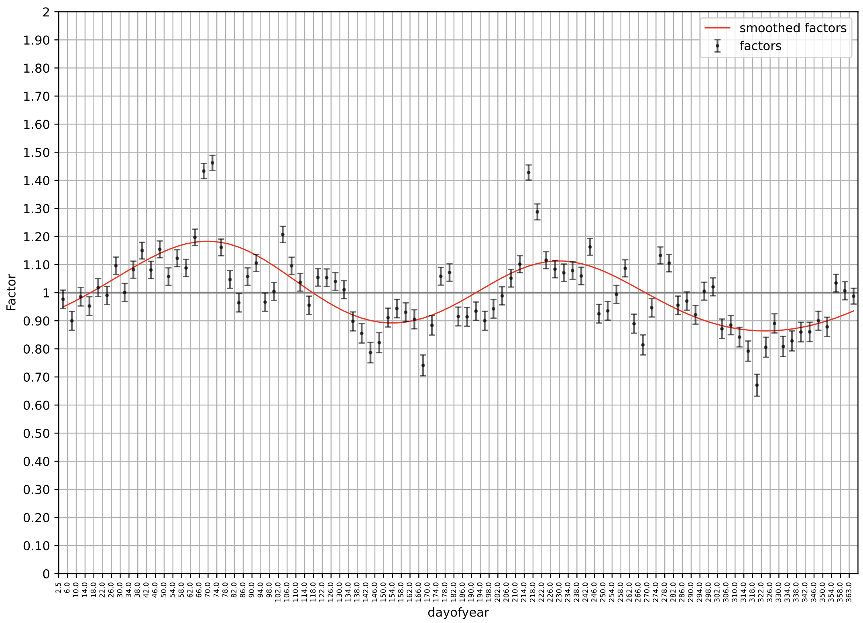
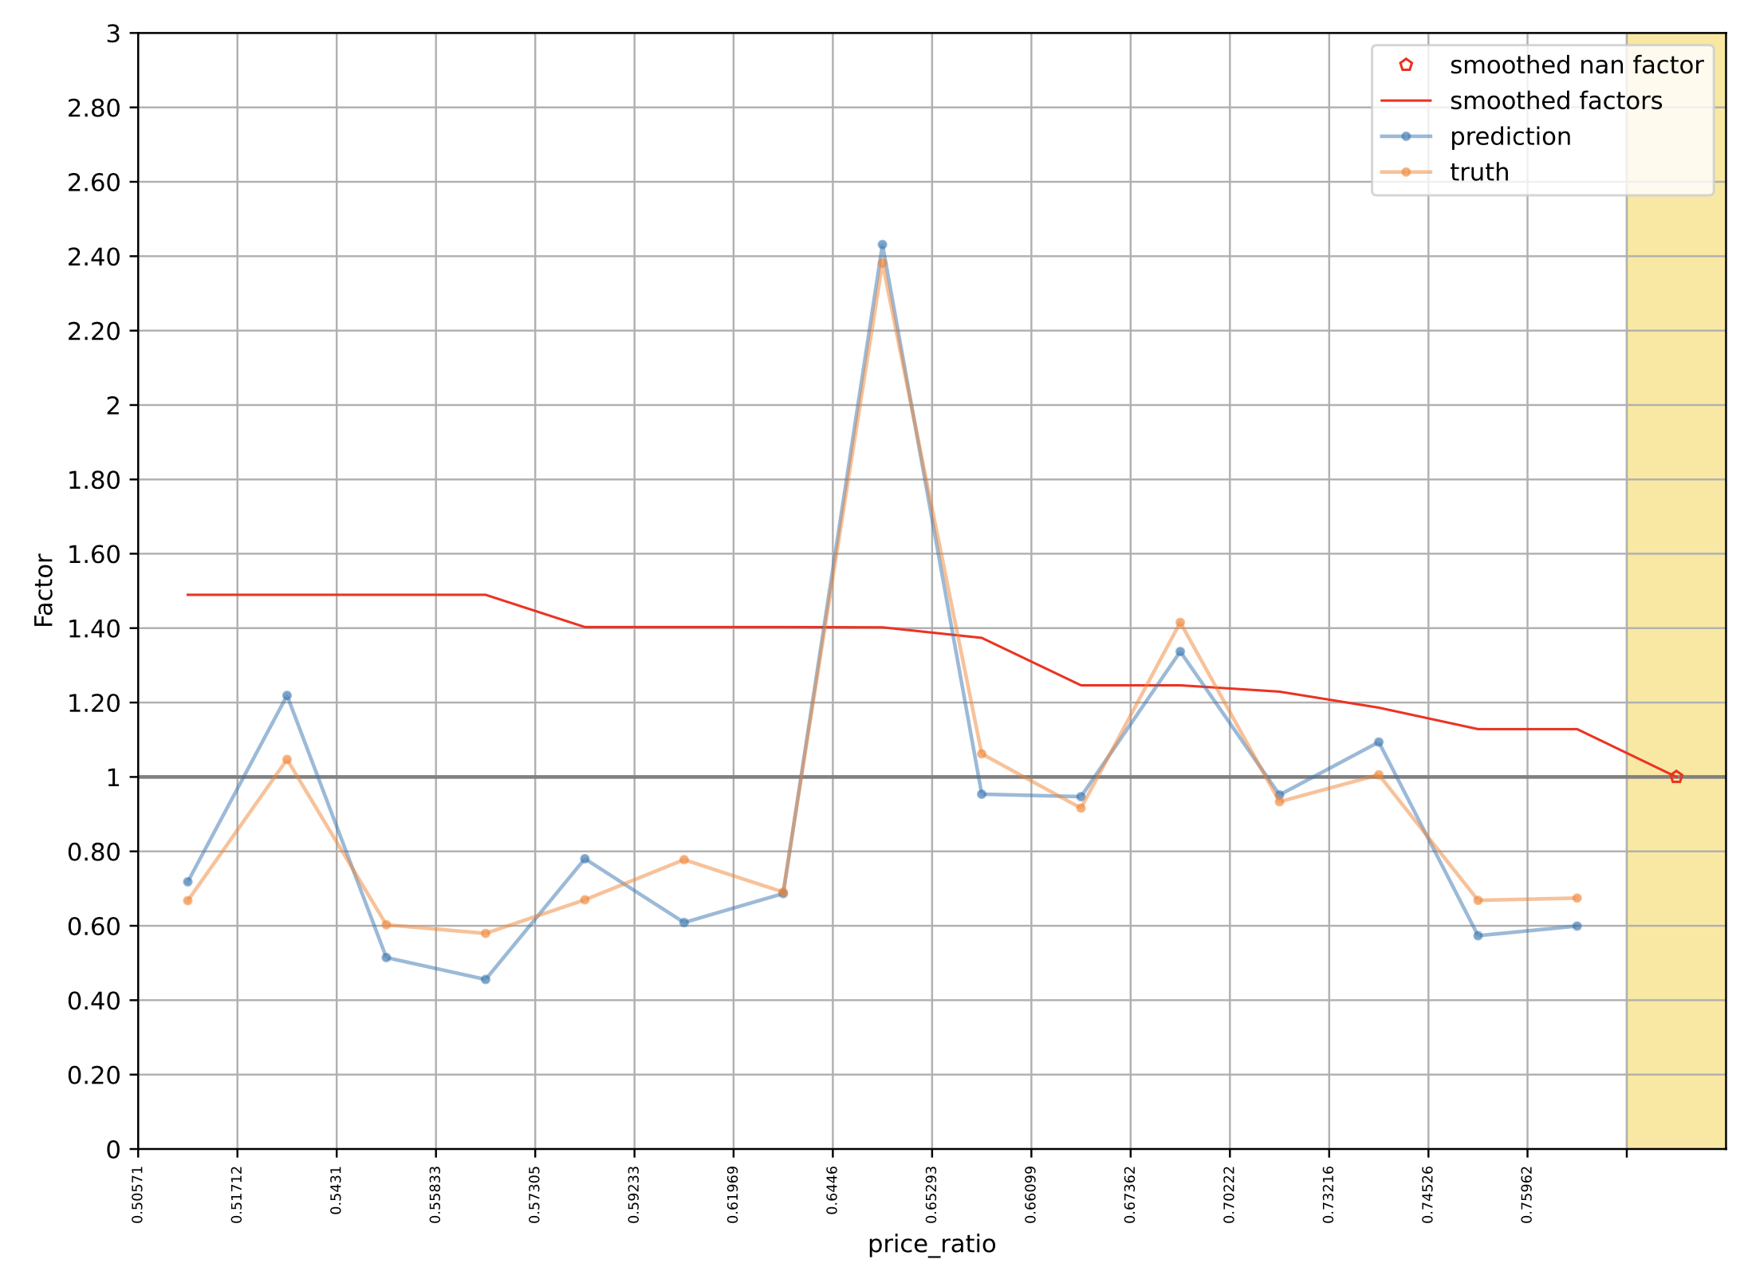
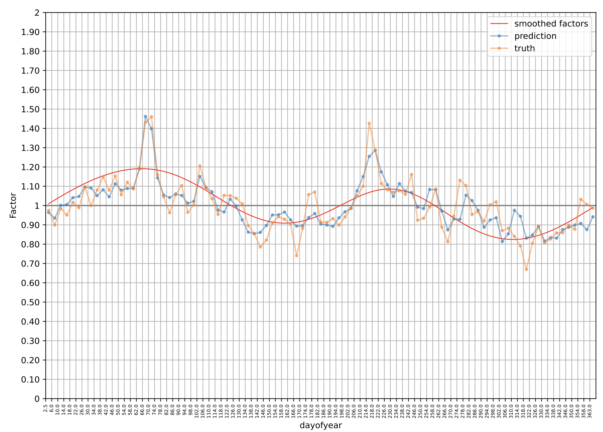
Smoothing
use fitted functions (smoothed factors) instead of original factors
to avoid overfitting:
regularization (smoothing) across bins → drastic reduction of variance by ignoring fluctuations
analysis after first iteration
separate smoothings in each iteration
in general: orthogonal polynomials
analysis after last iteration:
another way to include prior knowledge via
monotonic requirements
sinusoidal functions
(piecewise) linear
13

Slide 14
Analysis Plots
analysis after last iteration:
target mean in each bin
support EDA and modeling
model transparency → ease of development
automatically generated
Feature (bin) has an impact in the model, otherwise it will be 1.
Deviations between smoothed factors and predictions come from correlations with other features.
no price reduction: set to uninformative nan values
Deviations of predictions from truths show potential model weaknesses (biases) in different bins.
14

Slide 15



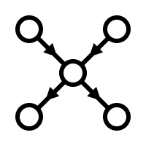
Cyclic Boosting | Characteristics
TOPOLOGY
OPTIMIZATION
PREREQUISITE
REGULARIZATION
Generalized
Additive Model
cyclic coordinate
descent
binning of features
Bayesian updates and smoothing of factor distributions
similarities to:
backfitting, forward-stagewise modeling (aka boosting)
LightGBM

Slide 16
Off-The-Shelf Method for Structured Data
“simple” algorithm, but robust and fast
few hyperparameters to be tuned
not much data pre-processing needed
easily configurable for different data types
supporting missing values in input data
assisting model development with individual analysis plots for features
allowing buiding of complex models by means of interaction terms
(multiplicative or additive) regression (location parameter)
classification
16

Slide 17
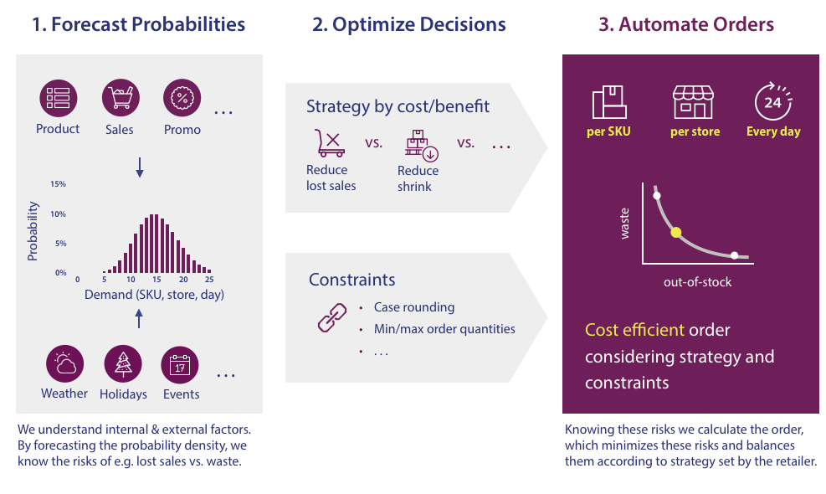
Other Modes: Width Prediction (Scale)
important busines application: automated replenishment
full, individual PDF predictions (e.g., probability distributions for each product-location-day combination)
by means of separate ML models for mean and variance (actually, indirect prediction of variance via dispersion parameter), assuming negative binomial distribution of target (e.g., demand) in maximum likelihood estimation
17

Slide 18
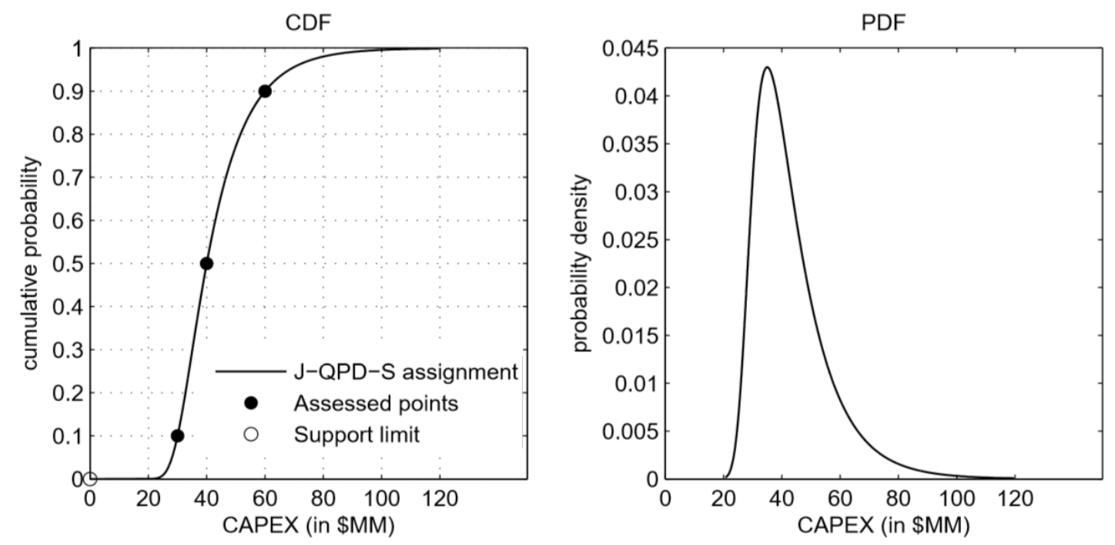
Alternative: Quantile-Parameterized Distributions (QPD)
idea: approximate full, individual probability distribution for each sample by using estimated quantiles
e.g., from Cyclic Boosting’s quantile regression mode (or any other quantile regression method)
quantiles as parameters of smooth distribution → no fitting, no strict functional assumption
Johnson QPDs (J-QPD) are parameterized by symmetric quantile triplet
implemented in Cyclic Boosting
J-QPD
18

Slide 19
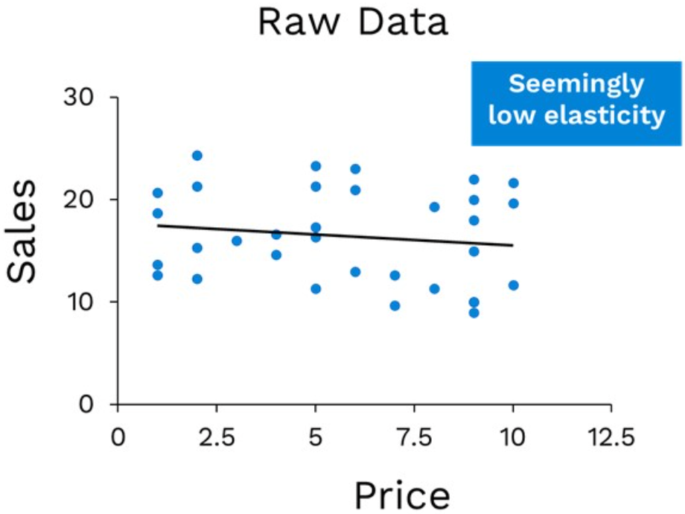
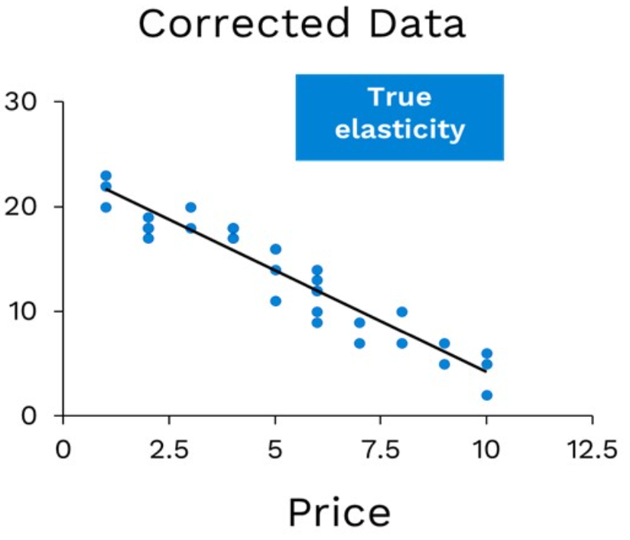
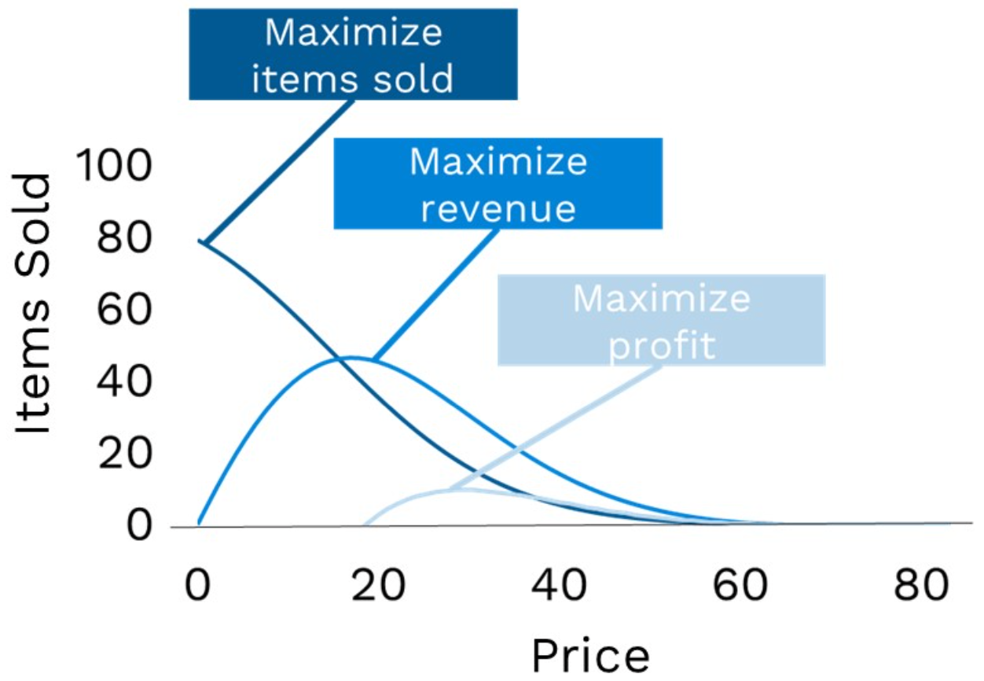
Other Modes: Elasticity Prediction (Shape), Background Subtraction
using factors in exponential terms
using negative sample weights
other business application: demand shaping by causal inference (mainly beyond ML/CB), examples:
dynamic pricing: influence demand of different products by price setting
customer targeting: influence individual customer demand by couponing (subtract unaffected customers)
confounded effect:
after de-confounding:
use for pricing policies:
usually exponential
19

